Slide 1
HealthOne regional meetings 2026
Greg Pszkit / Philip Donnellan

Slide 2
Dates
Sligo regional meeting
17/05/2026
Dublin regional meeting (with Zoom option)
13/06/2026
Limerick regional meeting
20/06/2026
Annual scientific meeting
07/11/2026

Slide 3
Agenda
Few new things
  Primary Childhood vaccinations submission and dashboard
  E-mail appointment reminder
  not sent prescriptions monitoring
  screen 2 text
Few old things
  DXM filtering
  Pneumococcal vaccines for non-GMS
Touch on IT security
  social engieering
  ClickFix
CompleteGP presentation

Slide 4

New stuff

Slide 5
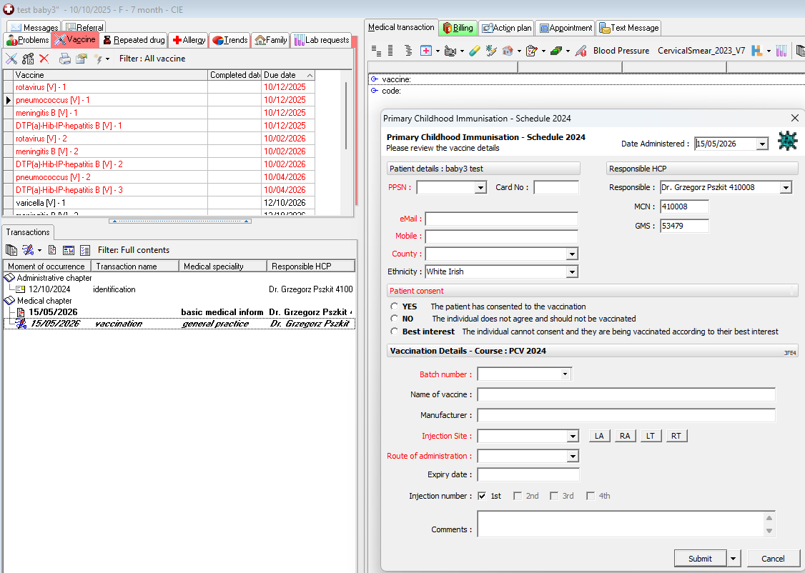
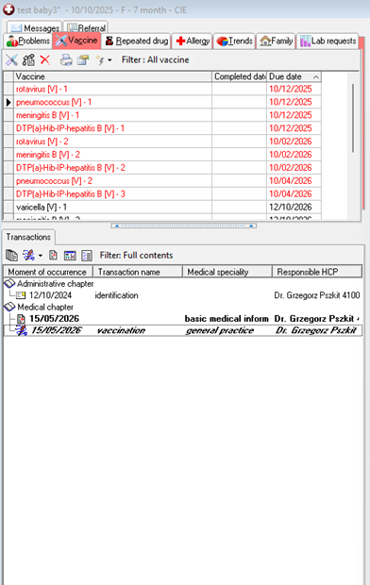
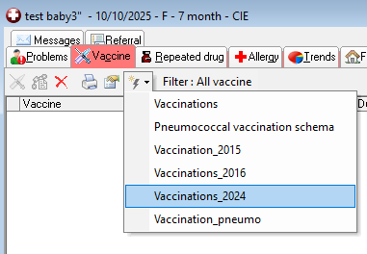
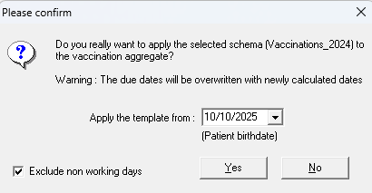
Primary Childhood Vaccinations
MUST be in basic medical transaction!

Slide 6

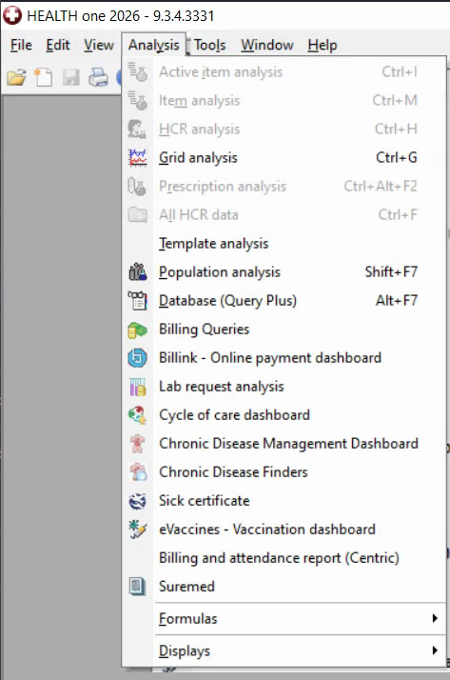
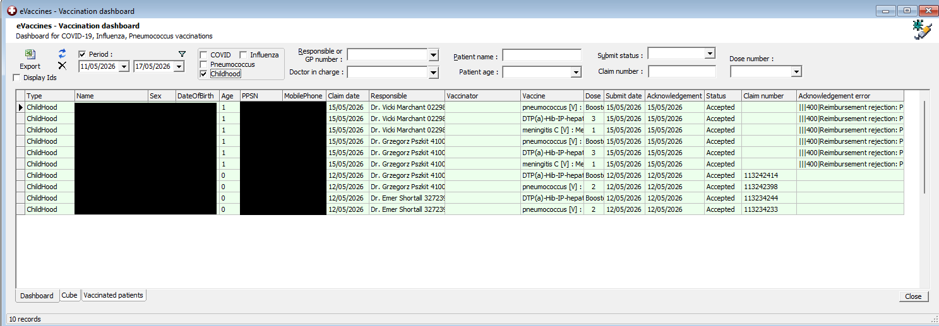
Primary Childhood Vaccinations

Slide 7
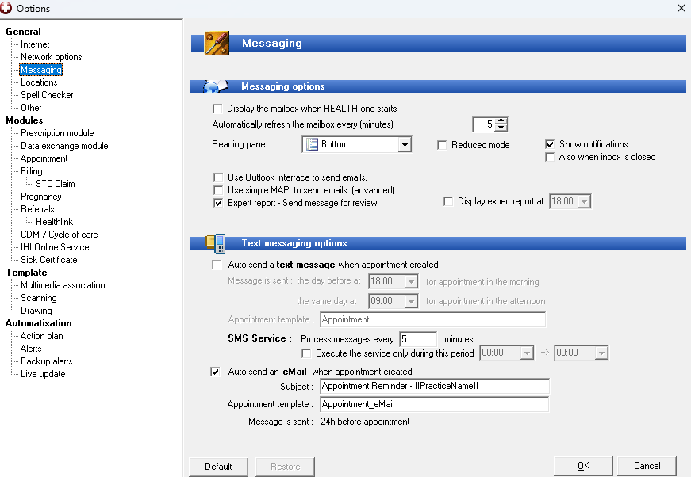
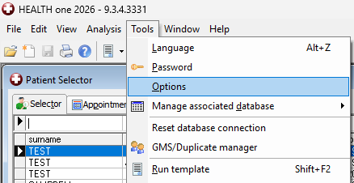
E-mail reminder about appointment

Slide 8
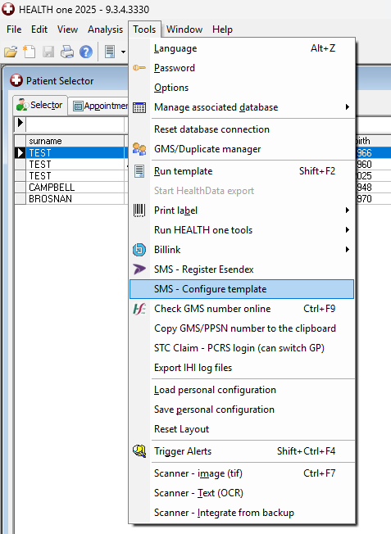
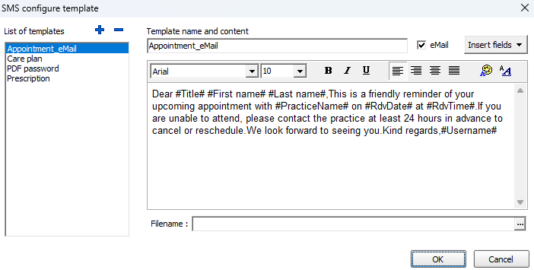
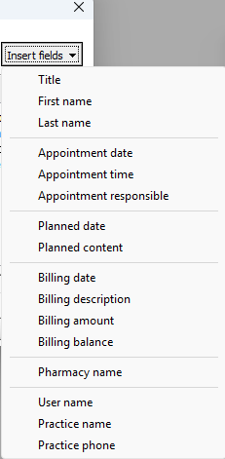
E-mail template editing

Slide 9
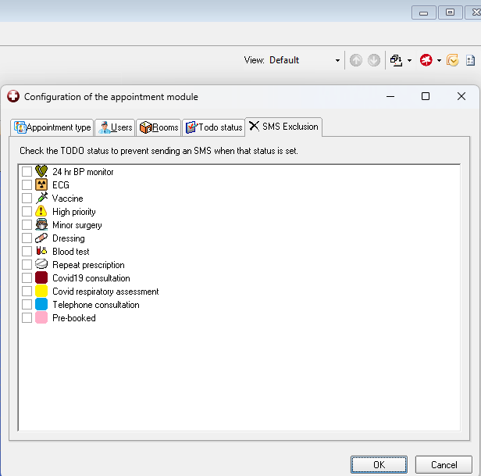
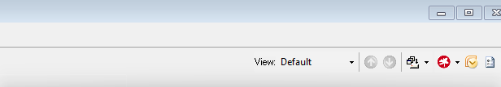
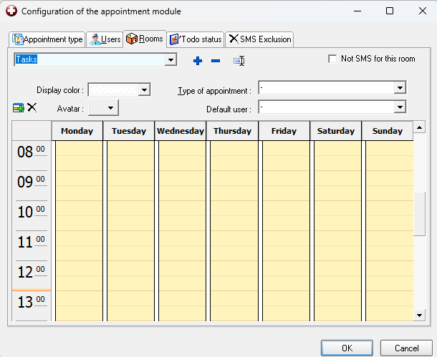
E-mail reminder exclusion

Slide 10
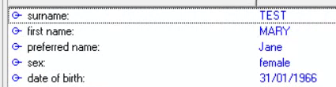
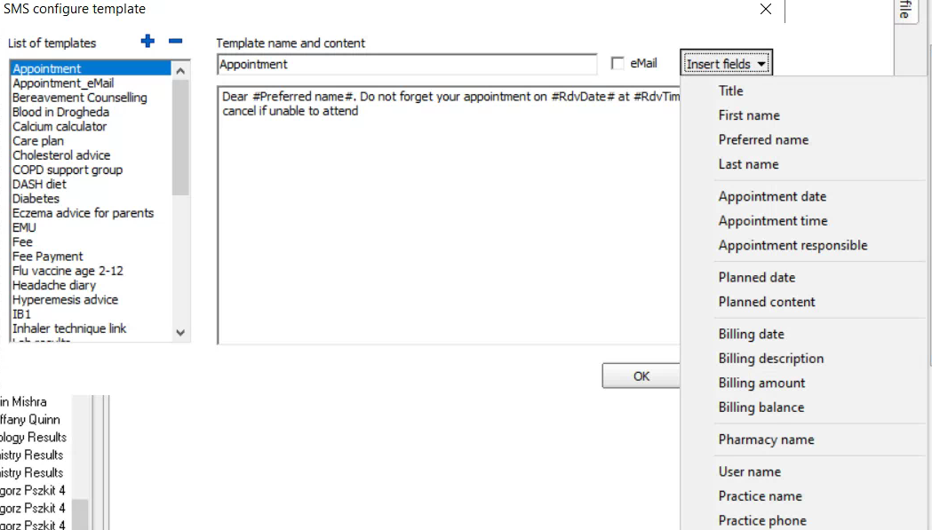
Preferred name use
If exists -> will be used
If does not exist -> fall back to First Name

Slide 11
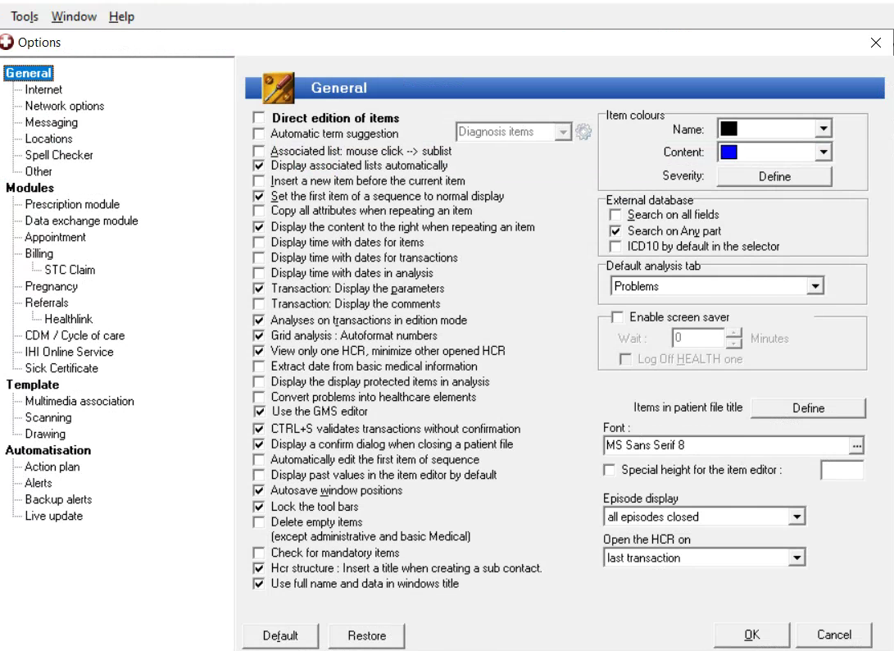
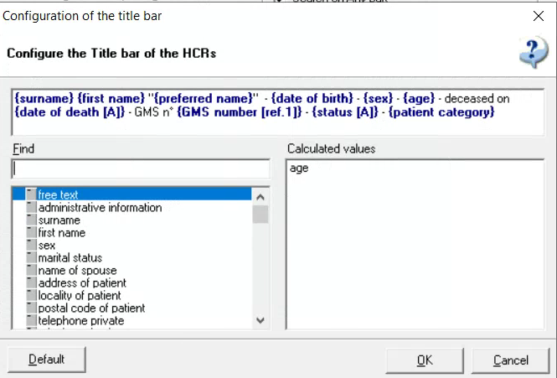

Slide 12
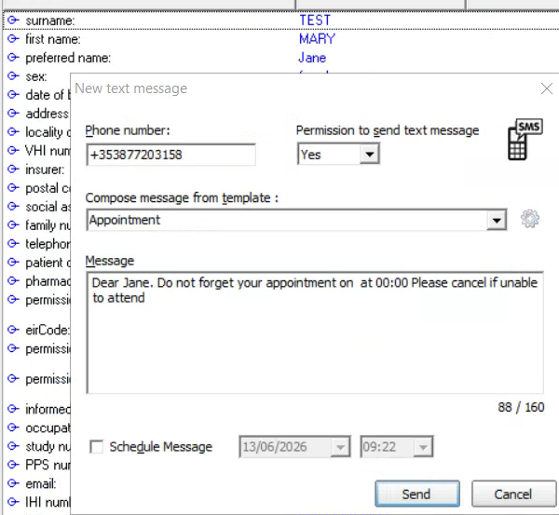
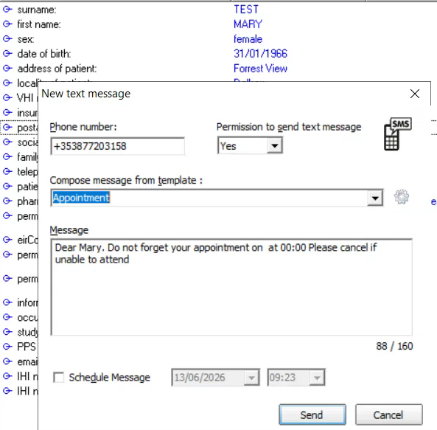

Slide 13
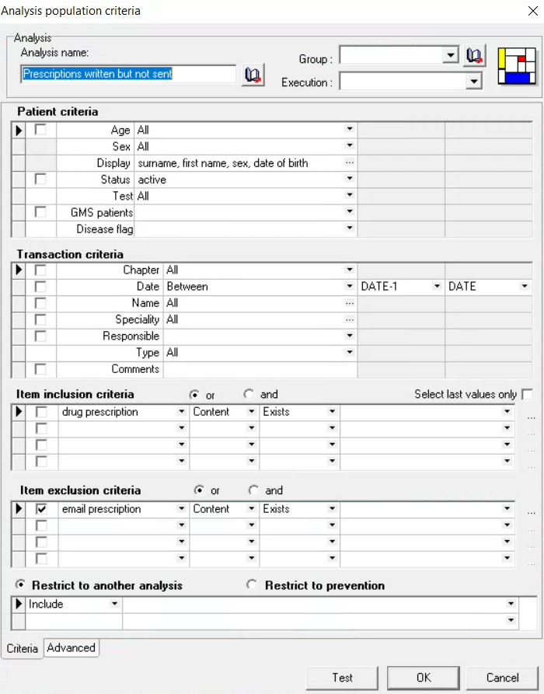
Not sent prescriptions
Logic:
  Item drug prescription is there
  But emal prescription is not
Hence, false positives:
  Updated private prescription
  Printed prescriptions

Slide 14
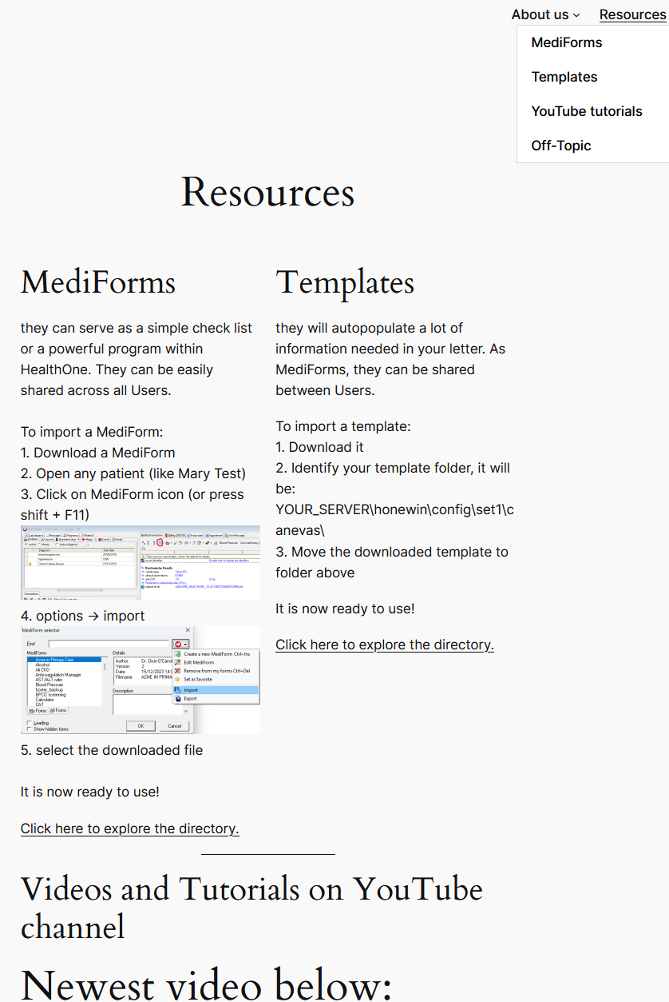

New website in making
https://new.hiug.ie/
Please share your favourite templates and Mediforms via mailing list

Slide 15
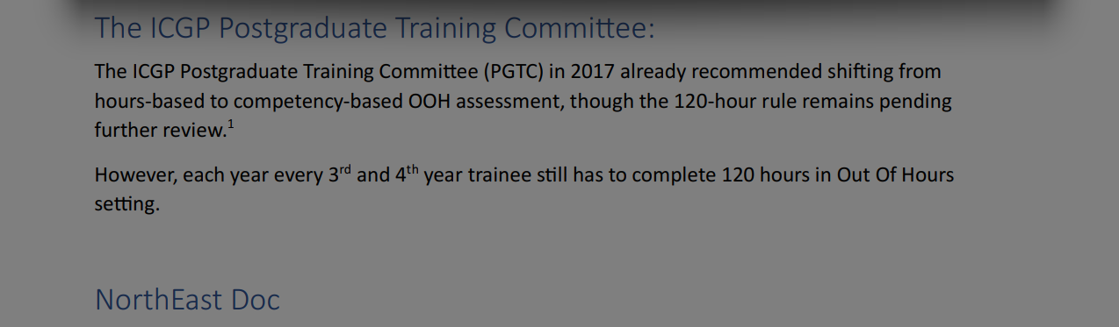
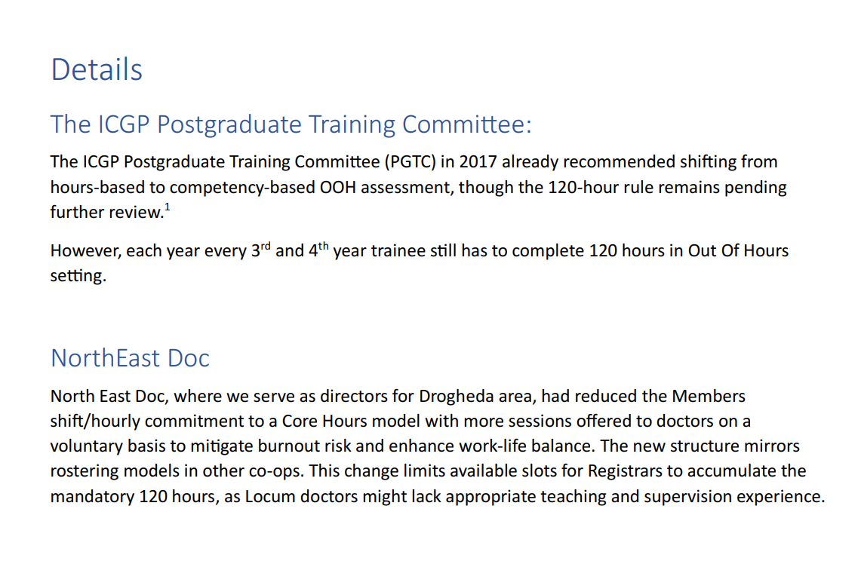

“screen2text”
The ICGP Postgraduate Training Committee:The ICGP Postgraduate Training Committee (PGTC) in 2017 already recommended shifting fromhours-based to competency-based OOH assessment;though the 120-hour rule remains pendingfurther review.:1However; each year every 3rd and 4th year trainee still has to complete 120 hours in Out Of Hourssetting:NorthEast Doc

Slide 16
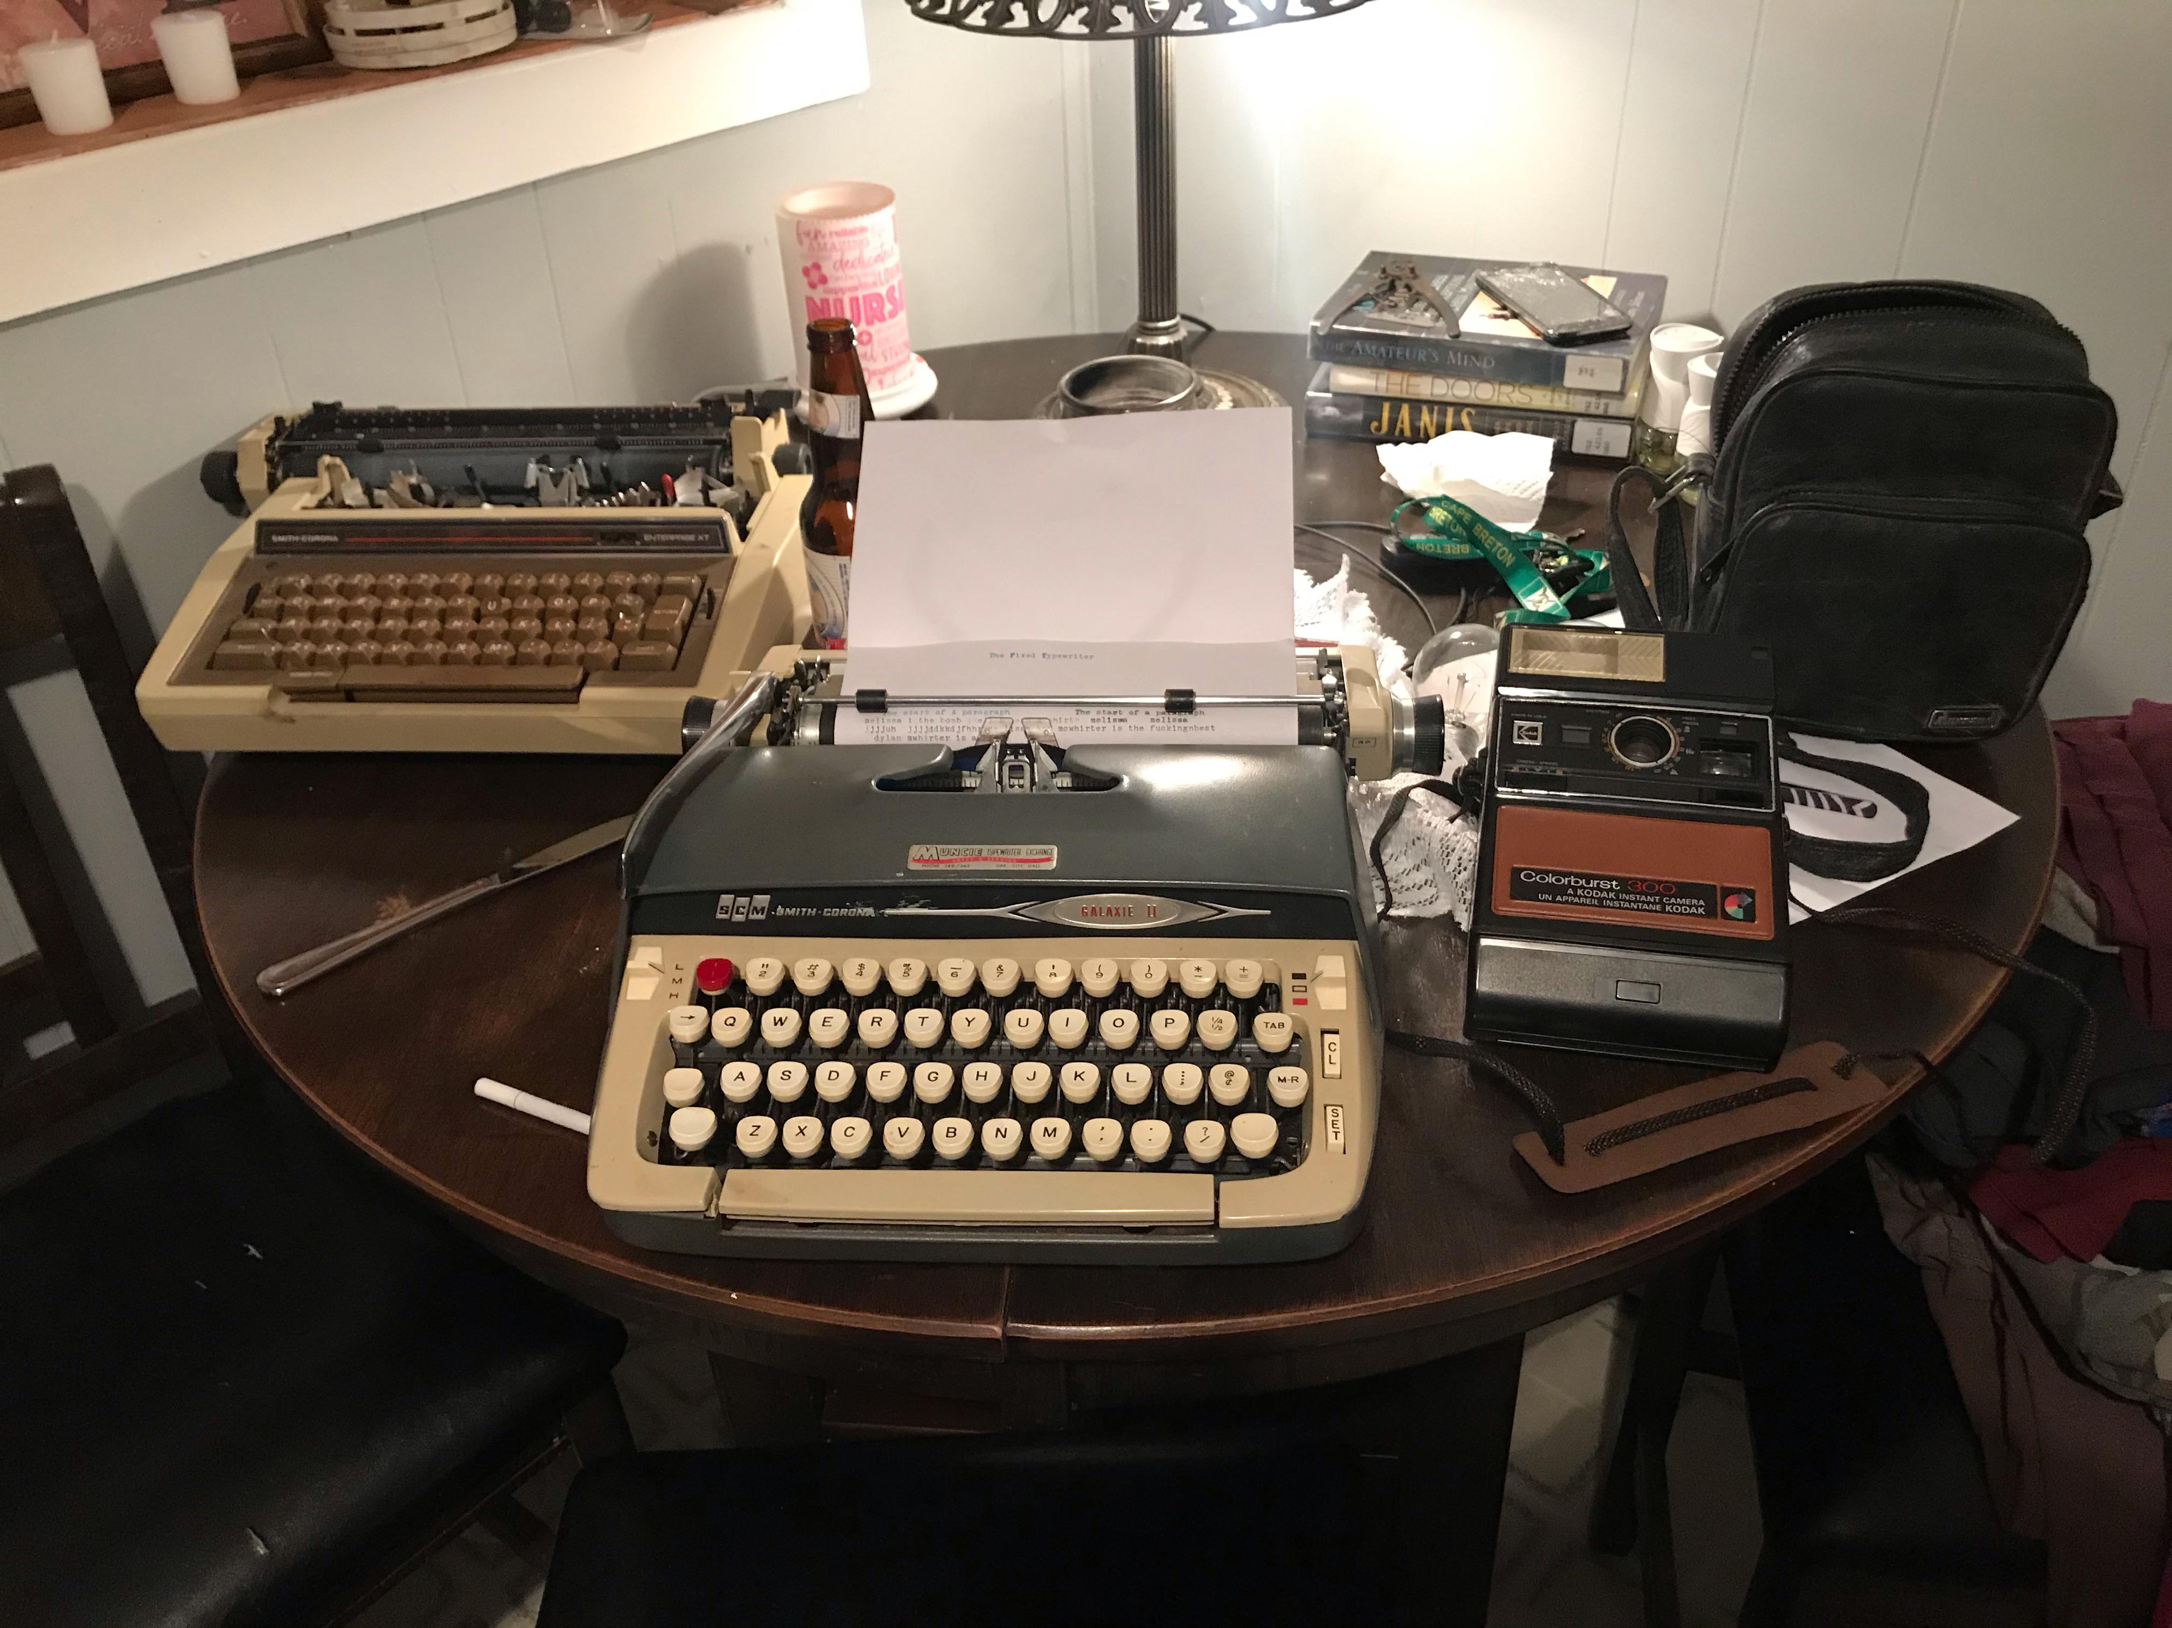
Recap on old (still good!) features

Slide 17
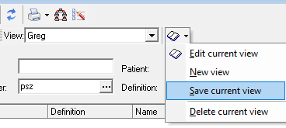
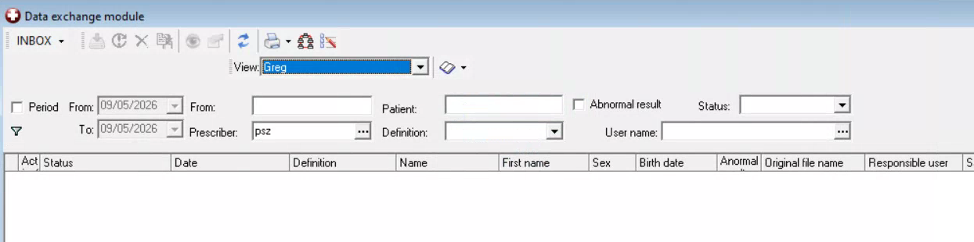
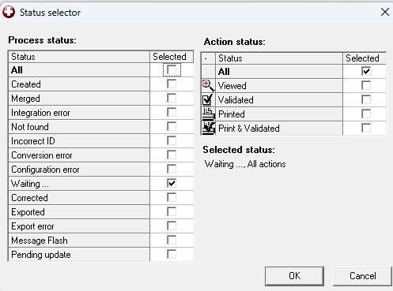
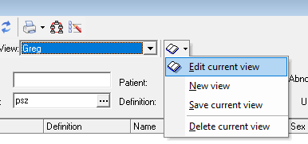
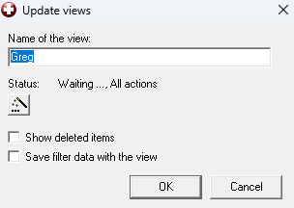
DXM filtering
Can use ; as OR operator

Slide 18
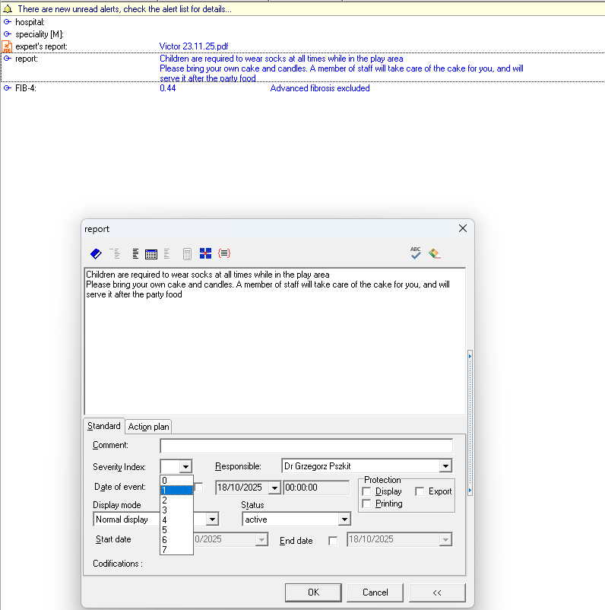
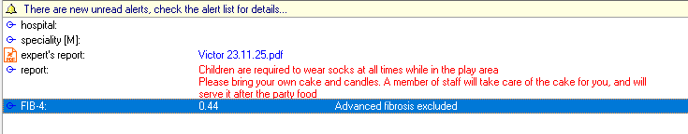
Highlighting content of item in red
Change severity index

Slide 19
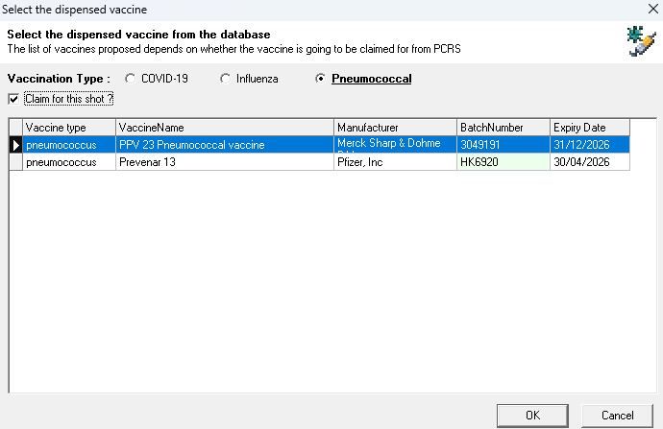
Pneumococcal vaccine non-GMS
We can use Cold Chain vaccines
We can charge for administration

Slide 20
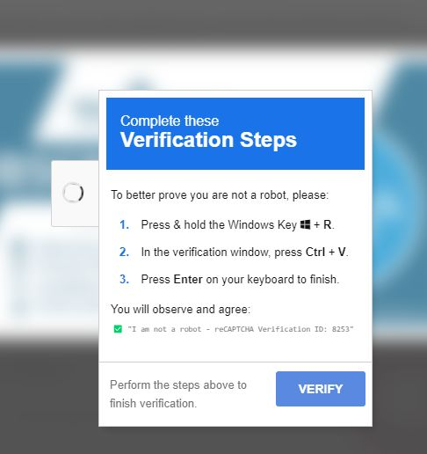
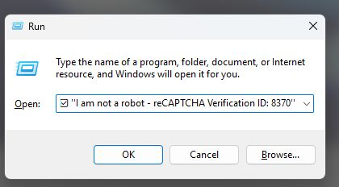

Touch on security
Social engineering
  “Afternoon,
  Anyone else getting a call from HealthOne support wanting to log on and fix a bug in Childhood Vaccinations?”
ClickFix (FakeCAPTCHA / clipboard hijack)
- leading cause of hacks!
mshta https://{malicious.domain}/media.file

Slide 21
Q&A

Slide 22
New Complete GP
Active collaboration
First site went live May 2026 as the pilot
Intense work on migration to maintain data granularity

Slide 23
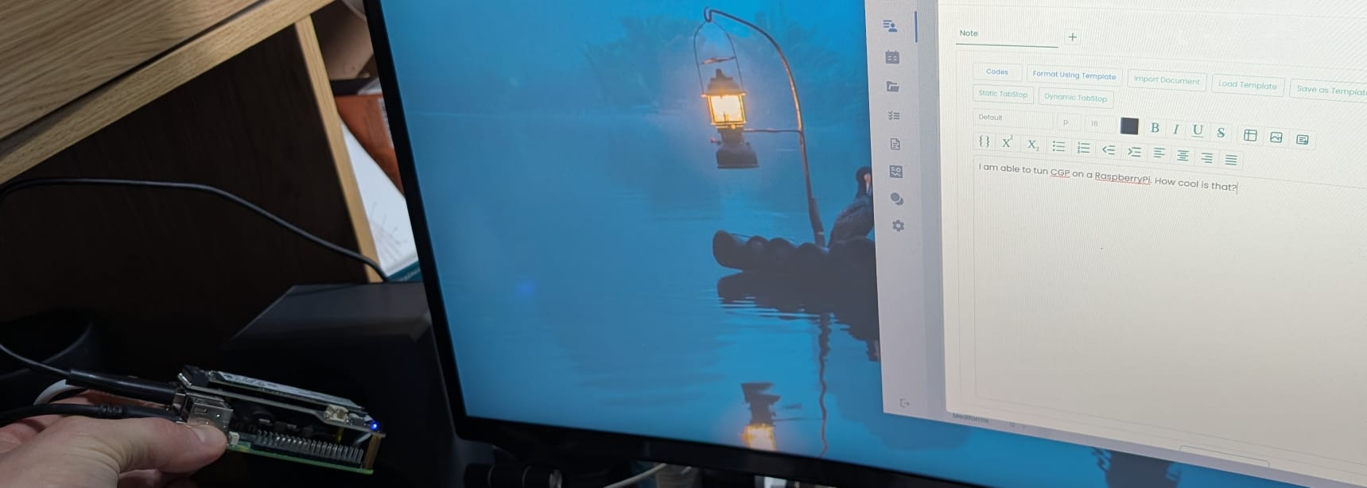
New CompleteGP running on a RaspberryPi!

Slide 24
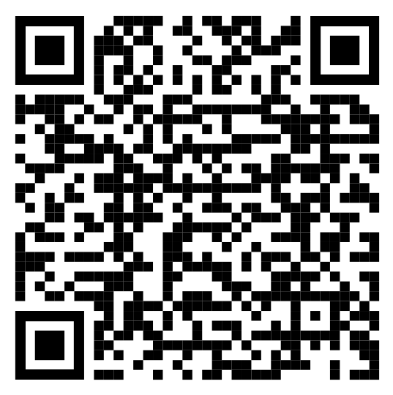
Register interest in migration
https://www.strandmedicalpractice.com/healthone-regional-meetings-2026#migration

Slide 25
Over to Philip!

